Slide 1

Infrastructure Architecture
Legacy Development & Deployment

Slide 2
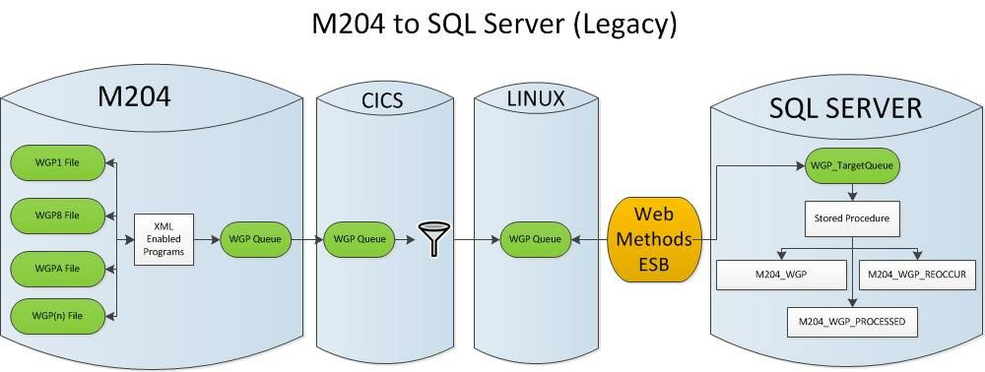
Overview

Slide 3
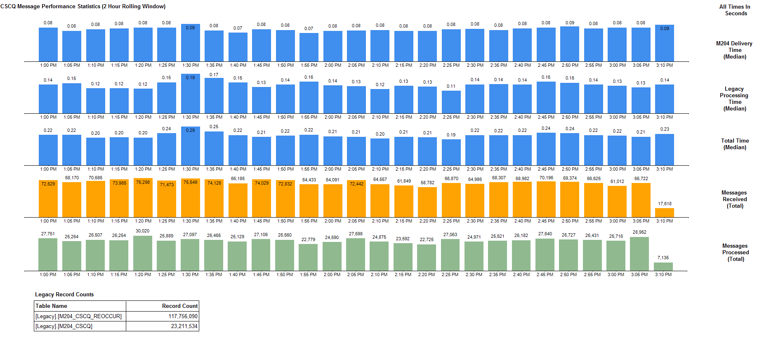
High-Speed Delivery

Slide 4
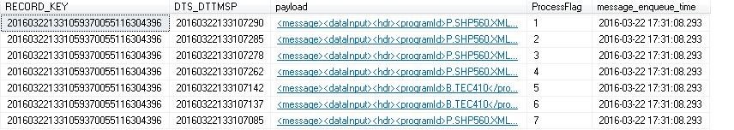

High-Speed Delivery (Processed Tables)
For WGP, in the span of 205 milliseconds 7 XML messages were generated for a single record
For CSCQ, in the span of 31 milliseconds 5 XML messages were generated for a single record
The Processed tables allow us store the original message payload for troubleshooting

Slide 5
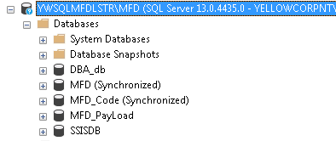
Legacy going forward
Legacy
Three physical databases (currently 2)
SQL Server 2016
Memory-optimized data types (for speed)
XML message compression (reduce latency)

Slide 6
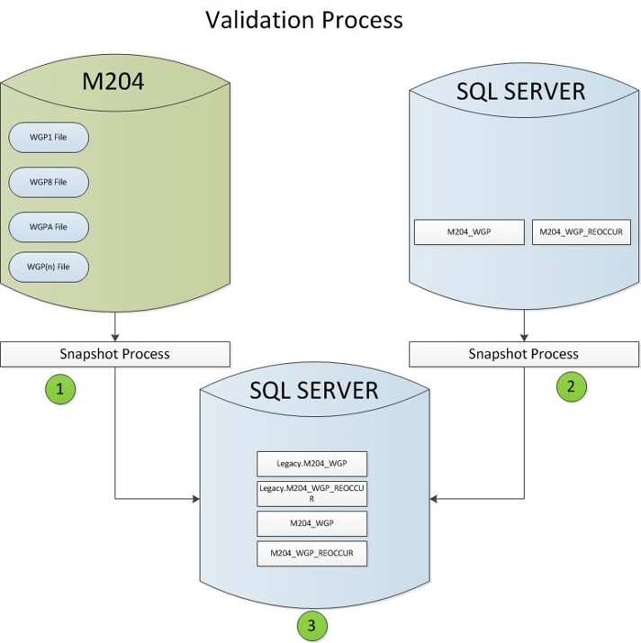
Validation Overview
A Snapshot is taken of M204 Data Files during the morning “bounce”. The data from the static snapshot is loaded into SQL Server tables which match the structure of Legacy
A Snapshot is taken of the Legacy Database which corresponds to the M204 Snapshot. This data is loaded into the same database as the M204 snapshot data
The tables sourced from M204 are compared against the tables sourced from Legacy. Any inconsistencies are logged into an exception table after which the inconsistent records are re-synced.

Slide 7
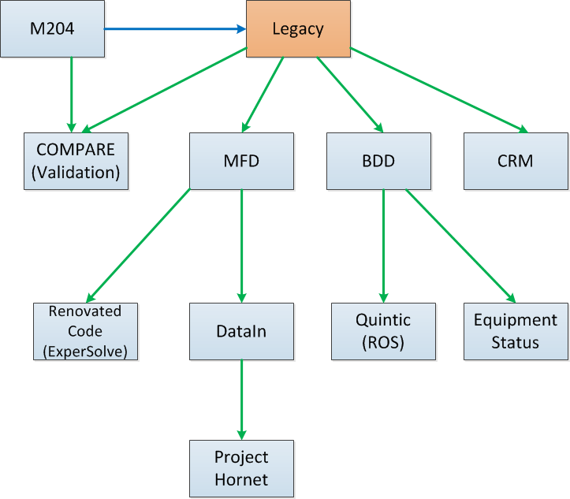
The Big Picture
Legacy supports:
New business applications
New System-of-Record (MFD)
Renovated M204 applications
New Data Warehouse (SAS Conversion)
Modernization Validation system

Slide 8
The Big Picture
Legacy supports:
New business applications
New System-of-Record (MFD)
Renovated M204 applications
New Data Warehouse (SAS Conversion)
Modernization Validation system
New in the last two weeks

Slide 9
The Big Picture
Legacy supports:
New business applications
New System-of-Record (MFD)
Renovated M204 applications
New Data Warehouse (SAS Conversion)
Modernization Validation system
ETL team expertise

Slide 10
The Big Picture
Scenarios:
Move a column
Change column data type
Make column Base64 encoding aware
Add or Delete column(s)
Add or Delete M204 file groups

Slide 11
The Big Picture
Scenarios:
Move a column
Change column data type
Make column Base64 encoding aware
Add or Delete column(s)
Add or Delete M204 file groups
Driven from the Data Dictionary by
Renovated Code requirements
Business requirements

Slide 12
The Big Picture
Legacy update requests this week:
FileGroup Column Action
XORZ ORZ_PRO_PREFIX Move to Reoccur Table
XORZ ORZ_RELAY_TIME Move to Reoccur Table
XORZ ORZ_TRNSFR_TIME Move to Reoccur Table
WEB VISIBLE Add to Base Table
RPT VISIBLE Add to Base Table
ATC RECTYPE Drop column from
Base & Reoccur Tables
TWGPRE RECTYPE Drop column from
Base & Reoccur Tables

Slide 13
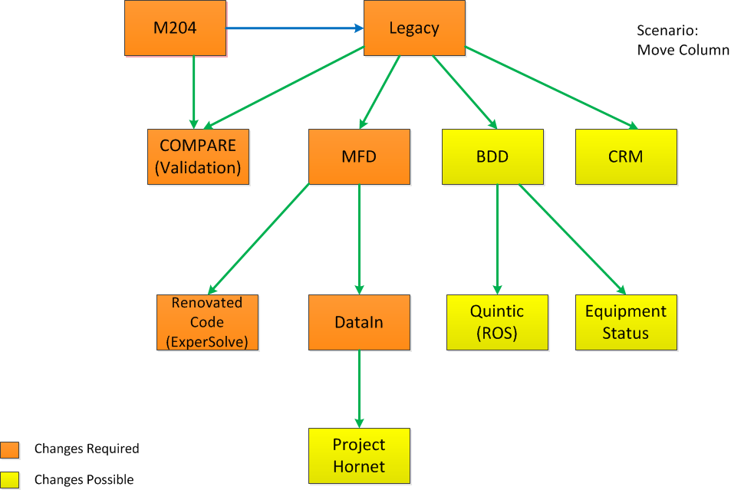
The Big Picture
Move a column:
DDL/DML changes
Scripts to preserve data
Re-push from M204 to re-create data

Slide 14
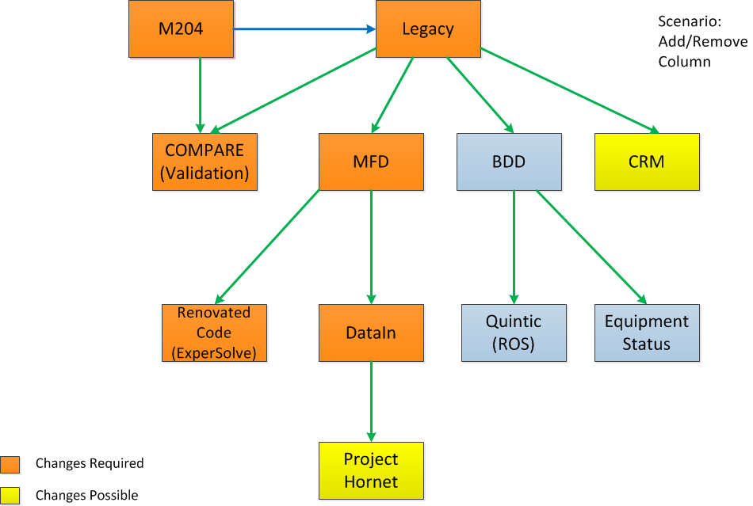
The Big Picture
Add/Remove a column:
DDL/DML changes
Re-push from M204 to add the data
Dropped columns may have BDD impact

Slide 15
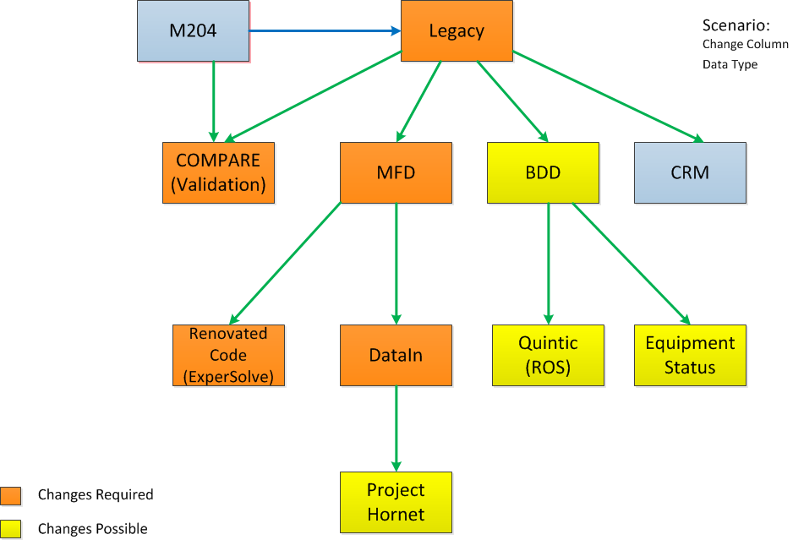
The Big Picture
Change column data type:
DDL/DML changes
Scripts to preserve data for large tables
BDD—data that used to fail no longer does

Slide 16
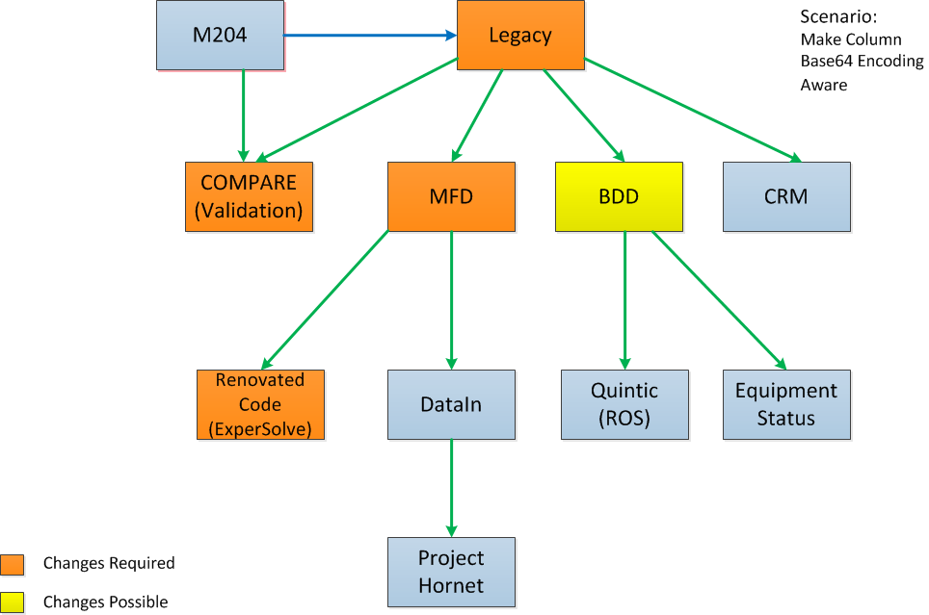
The Big Picture
Make column Base64 encoding aware:
DML changes (to include encode/decode)
Scripts to preserve data
BDD—data that used to fail no longer does

Slide 17
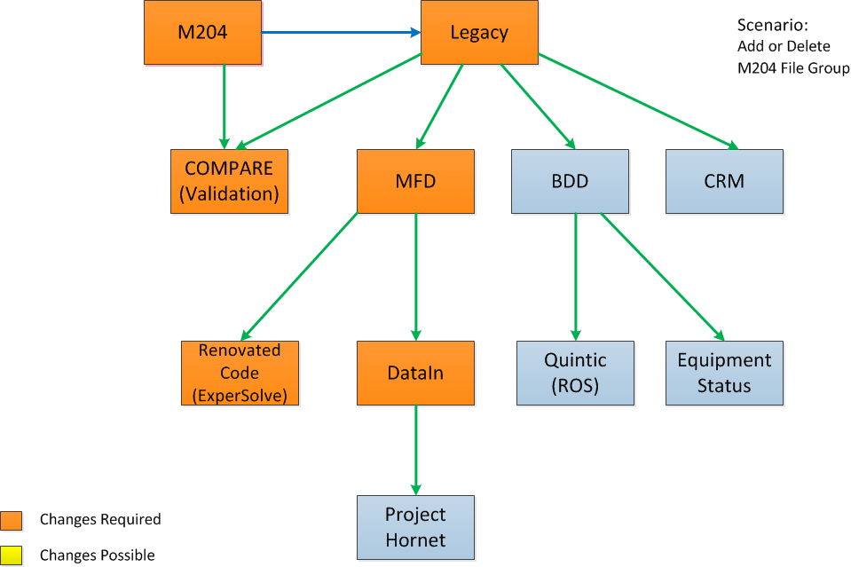
The Big Picture
Add/Remove M204 file groups:
New tables/Queues/Services/Routes/Synonyms
New stored procedures/parsers/functions
New publication(s) to DataIn
Removal of the above in the case of Delete

Slide 18
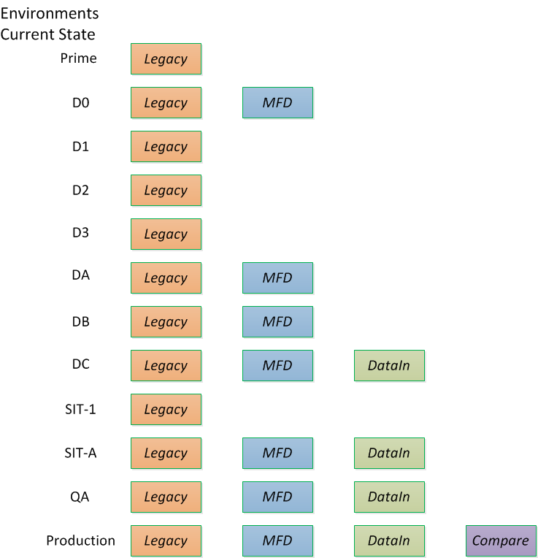
The Bigger Picture
The prior-referenced changes cascade:
Legacy and MFD Development uses Prime and Dev 0 (Legacy and MFD)
BDD/Apps use multiple Dev environments
Renovated code uses Legacy/MFD B (and Production)
DataIn uses Legacy/MFD C for development
Validation uses Legacy Prod and Compare

Slide 19
Code Generation
1
Code Generators
Current pace of development only possible via code generation:
Legacy Objects
Broker Objects
Table Structures
Assemblies/Functions
Stored Procedures
MFD Objects
Broker Objects
Table Structures
Assemblies/Functions
Stored Procedures
DataIn Objects
Table Structures
Replication Code
M204 Funloads
Validation Stored Procedures
JPA Code
4
2
5
6
3

